Slide 1
Shahmaran
The Prepared:Zeynep Taşdan
Please watch it on the slide mode.

Slide 2
What is Shahmaran?
Shahmaran literally, shah (king) of the snakes.) is a mythical creature from the folklore of the Kurdish people in Eastern Turkey, today's Southern, Central and Eastern Anatolia, Iran and Iraq.

Slide 3
The name of Shahmaran comes from words "Shah" and "Maran". "Shah" is the Iranic title for a king, primarily the leader of the Iranians and their land and "Mar" means snake in Kurdish and Persian language . In plural "Mar-an" means snakes. Shahmaran is known as the queen of the serpents.

Slide 4
Legend
Thousands of years ago, there were snakes living in the underground. Their names in Persian are maran and they were all wise and caring. They lived in peace. The queen of marans is called Shahmaran.

Slide 5
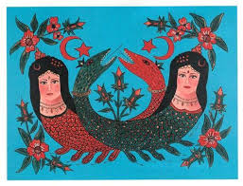

Slide 6
She is young and beautiful lady. According to legend, Cemshab is the first human being to have seen them. He sells wood for a living. One day he and his friend explored a cave with full of honey; but his friends are badly persons so they leave him in cave so they can take more honey.

Slide 7
After Cemshab see a hole in cave there is light. He enlarged it he encounter a garden that is magnificent. He enters the garden. There are flowers and snakes. One of them is most beautiful that's coloured is milk-white. He gain her trust, he live for long years there. After years he insisted to go for seeing his family. So Shahmaran let him go providing that he won't tell anyone where she is.

Slide 8
He gain her trust, he live for long years there. After years he insisted to go for seeing his family. So Shahmaran let him go providing that he won't tell anyone where she is.

Slide 9
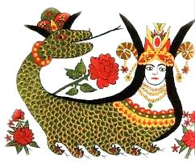

Slide 10
He keep his word for long time. But one day sultan of land get sick, vizier says that only cure is eating meat of Shahmaran and Cemshab shows the way. She says to şehmab "make me boil in earthenware dish.let the sultan eat my meat and make vizier drink my boiled water".

Slide 11
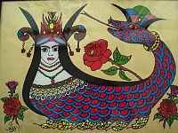
A woman with snake body.

Slide 12
When it happens vizier died, sultan keep living. Cemshab become vizier. According to legend snakes don't know Shahmaran is dead. One day snakes will occupy Tarsus when they learn it.

Slide 13
Thank you for watching! I hope you like it!
LOVES,
Zeynep Tasdan.

